Slide 1


Introduction to Excel
Acciojob/ Excel

Slide 2
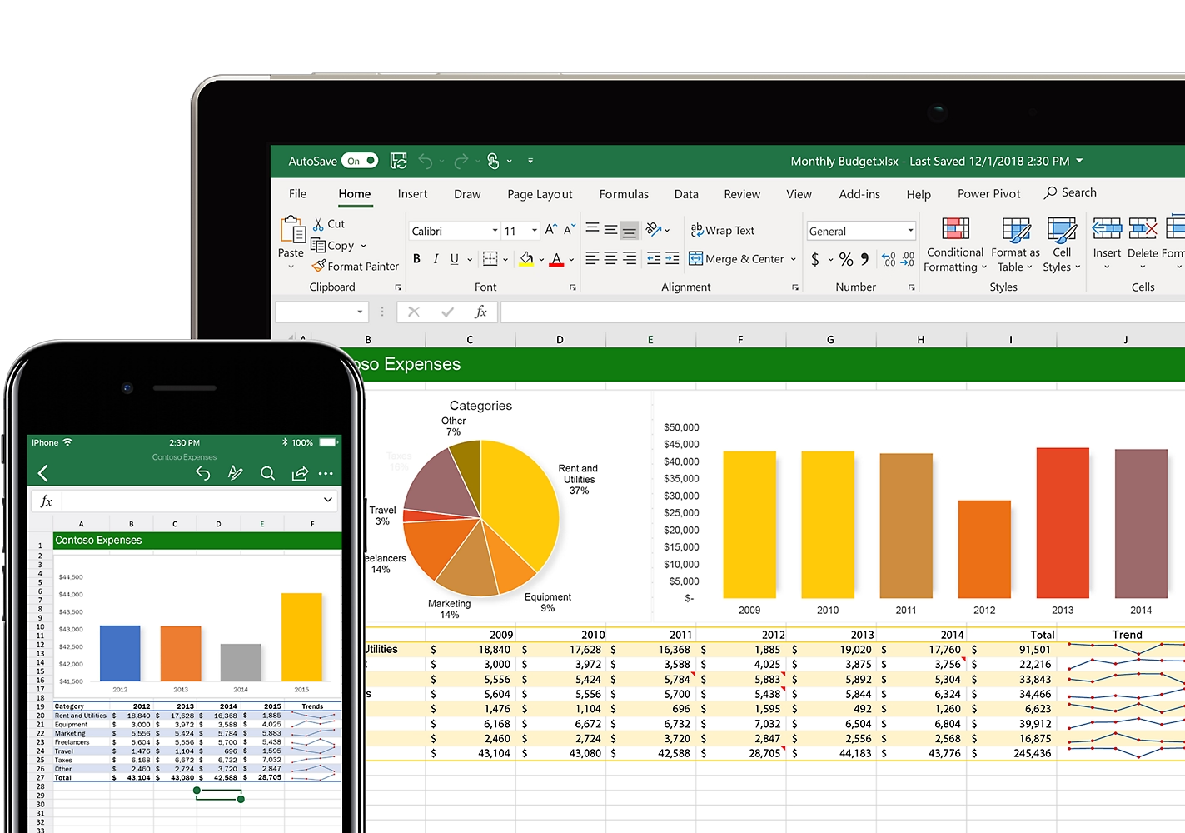
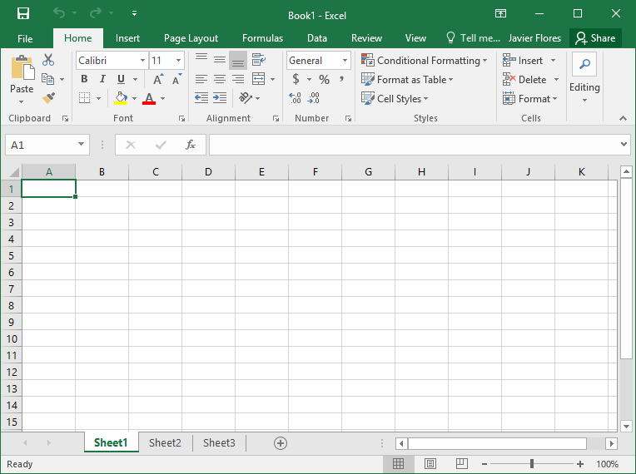
Introduction
Excel is a widely recognized and versatile software tool that holds significant importance in the field of data analytics.
With its robust features and user-friendly interface, Excel has become an integral part of data analysis, visualization, and reporting processes across industries.
As businesses increasingly rely on data-driven insights to make informed decisions, Excel provides the necessary functionalities to handle and analyze vast amounts of data efficiently.

Slide 3



Data Analysis
Excel offers a wide range of built-in functions and formulas that enable data analysis and calculations.
Analysts can perform various statistical operations, such as sum, average, count, and standard deviation, using Excel's formulas.
Excel's extensive library of functions allows for advanced calculations, including financial, mathematical, logical, and text-based operations.

Slide 4

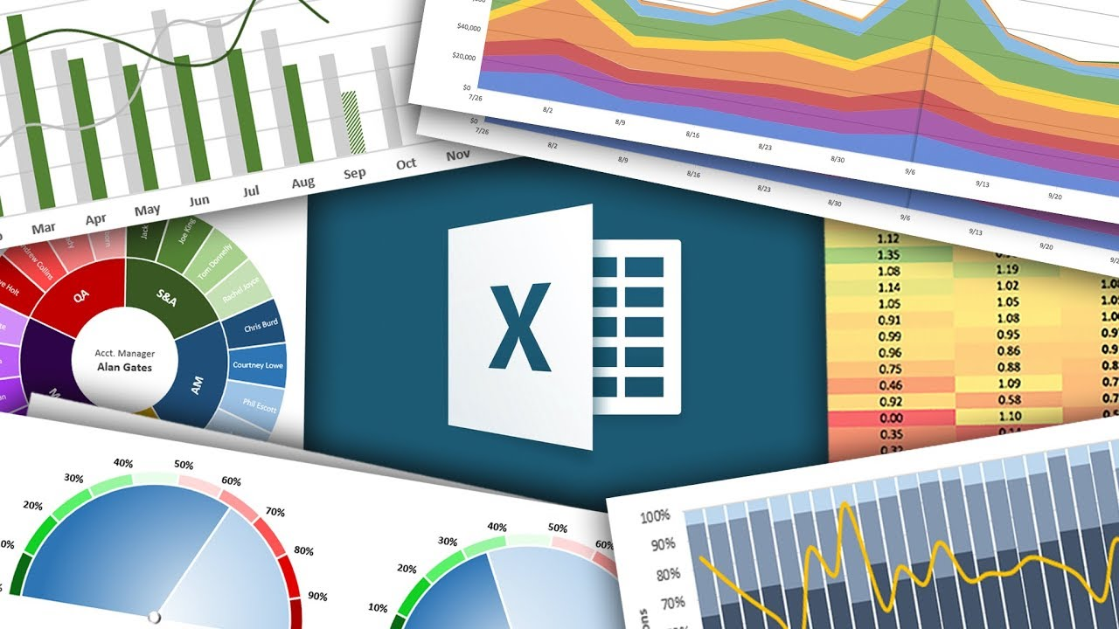
Data Visualization
Excel provides powerful visualization capabilities to represent data in a visually appealing and easily understandable manner.
Analysts can create charts, graphs, and pivot tables within Excel to visualize patterns, trends, and relationships in the data.
These visualizations enhance data comprehension, enabling stakeholders to grasp insights quickly and make informed decisions.

Slide 5
Industry Relevance
Excel finds extensive usage across industries, including finance, marketing, human resources, supply chain management, and more.
Financial analysts rely on Excel for budgeting, financial modeling, and forecasting.
Marketers utilize Excel for campaign analysis, customer segmentation, and performance tracking.
Human resources professionals leverage Excel for workforce analytics, employee data management, and payroll analysis.
Excel's versatility and adaptability make it applicable to a wide range of industry-specific data analysis needs.

Slide 6
Excel Week-1
Week | Class | Module Name | Sub Module
Week-1 | Class -1 | Data Analytics | What is data, Why is it important, industry use cases
 |  |  | General Tools
 |  |  | Why Excel
 |  | Introduction to Excel | Introduction to the Excel
 |  |  | Navigating and Selecting Cells
 |  |  | Working with Rows, Columns, and Worksheets
 |  |  | Entering and Editing Data
 | Class-2 |  | Formatting Cells and Text
 |  |  | Conditional formatting
 |  |  | Format as table
 |  |  | Cell styles
 |  |  | Basic excel things
 |  | Introduction to data | Introduction to data set
 |  |  | Introduce the problem statement
 |  |  | Understanding the data 1. Data granularity - Defining the two tables and column and entry - unique identifier 2. Data types 3. Intro to Filter - first show data without filter, emphasising on the need of filter 4. (??) Intorduce conepts for formulae, arithemtic formulae

Slide 7
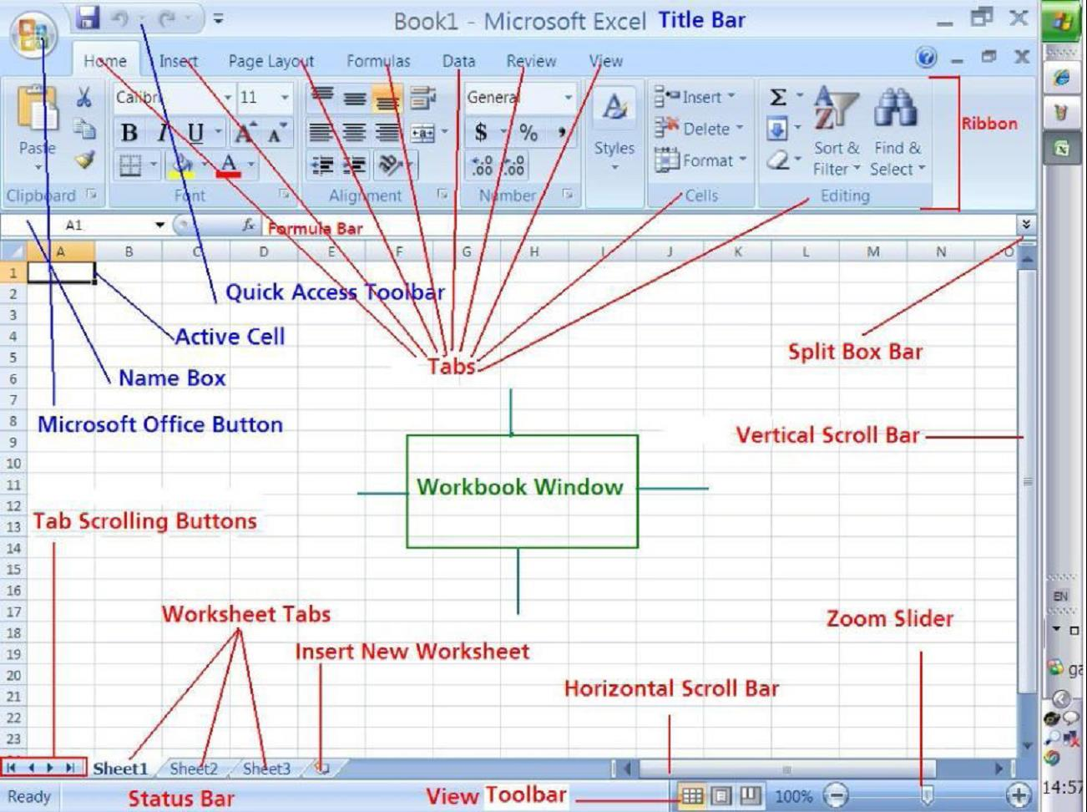
Introduction to Excel

Slide 8
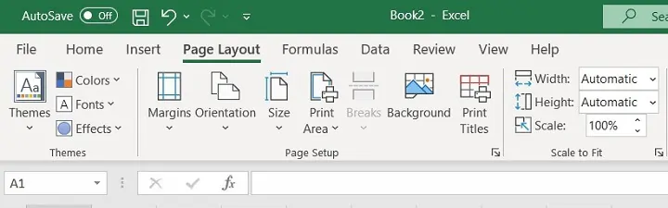
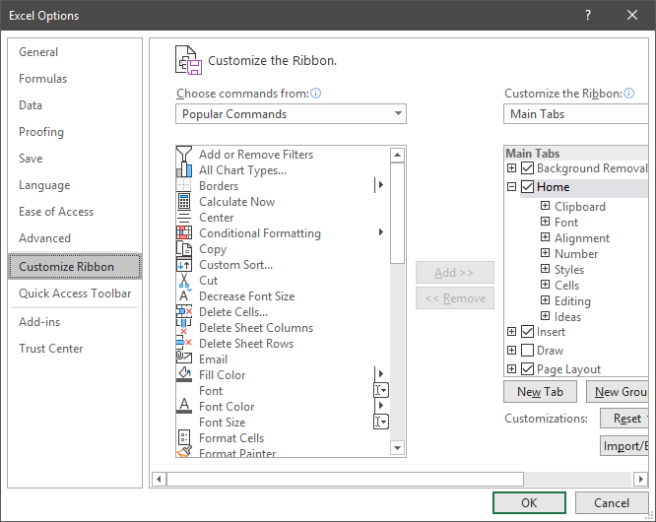
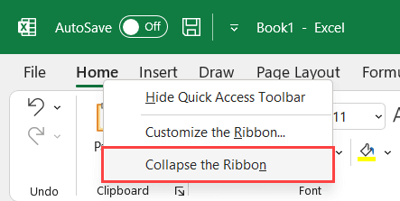
Customize ribbons in Excel

Slide 9
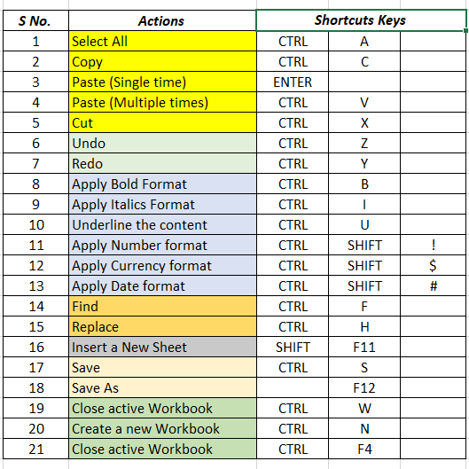
Basic Excel Shortcuts
Useful Shortcut that will help you during the excel learning journey

Slide 10
Basic Formatting
Basic formatting in Excel refers to the process of applying visual enhancements to cells, ranges, and worksheets to make data more readable and visually appealing.
Proper formatting not only improves the overall aesthetics of a spreadsheet but also helps in better data interpretation and analysis.Some Basic formatting are -
Font Formatting
Cell Formatting
Conditional Formatting
Worksheet Formatting

